Slide 1
July 28, 2015 Progress Update
Sunwoo Yim

Slide 2
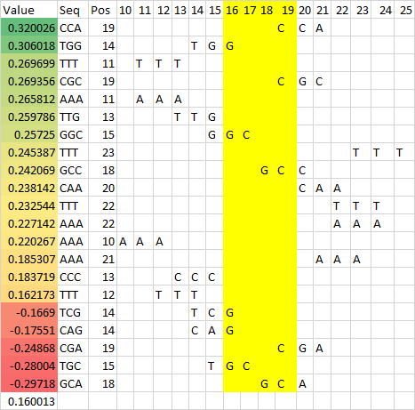
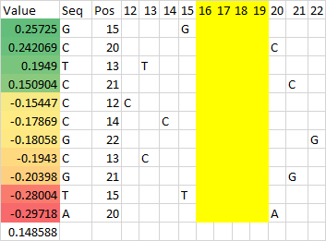
E2F1 GCGC
Notes:
BarGraph_E2F1_CoreGCGC_Feat13

Slide 3
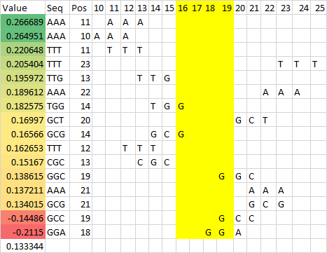
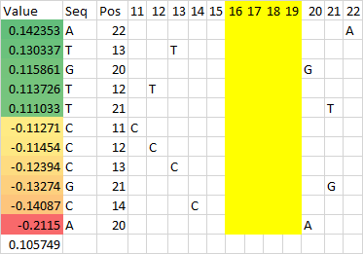
E2F1 GCGG
Notes:
BarGraph_E2F1_CoreGCGG_Feat13

Slide 4
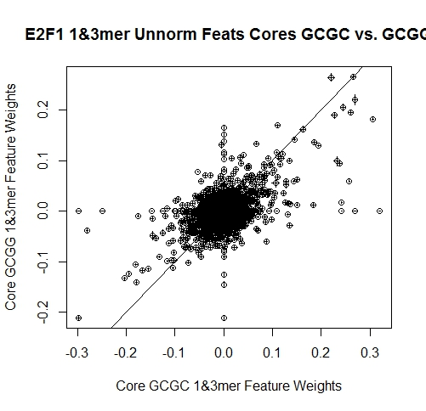
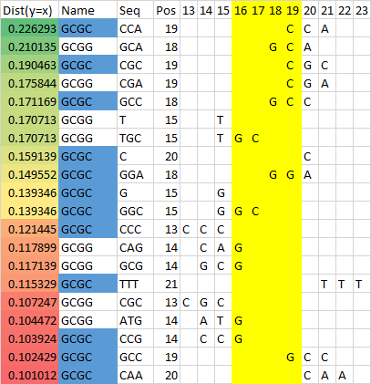
E2F1 Unnorm
Notes:
E2F1 comparison unnormalized
weights_E2F1_GCGCvsGCGG_unnormalized
graph_weights_E2F1_unnormalized

Slide 5

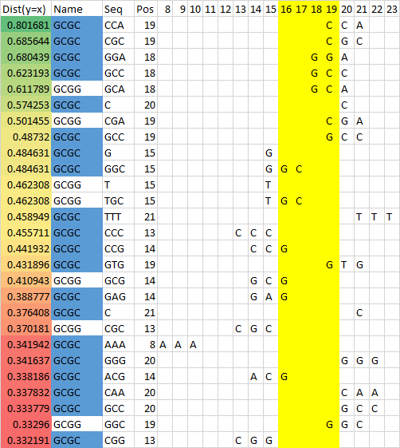
E2F1 Norm
Notes:
E2F1 comparison normalized
weights_E2F1_GCGCvsGCGG_normalized
graph_weights_E2F1_normalized

Slide 6
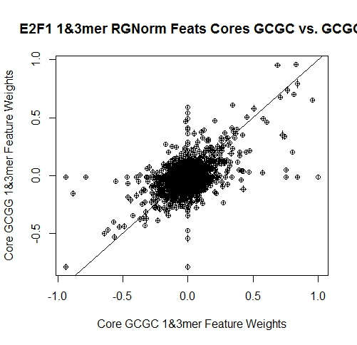
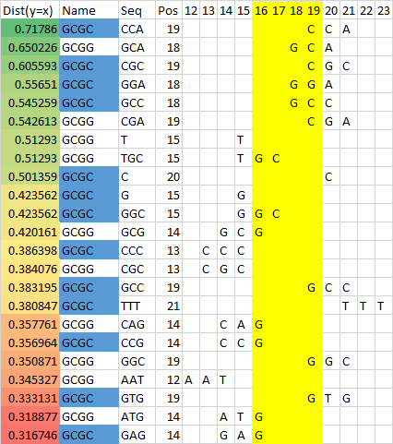
E2F1 RG Norm
Notes:
E2F1 comparison RG normalized
weights_E2F1_GCGCvsGCGG_RGnormalized
graph_weights_E2F1_RGnormalized

Slide 7
E2F1 Ranking
RG Norm
Ranking
Notes:
E2F1 comparison ranking
Ranking_E2F1_GCGCvsGCGG

Slide 8
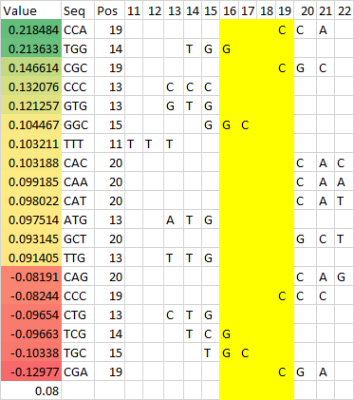
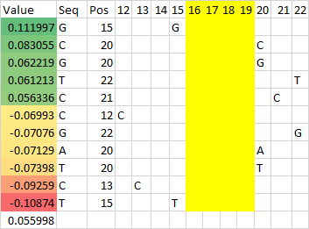
E2F4 GCGC
Notes:
BarGraph_E2F4_CoreGCGC_Feat13

Slide 9
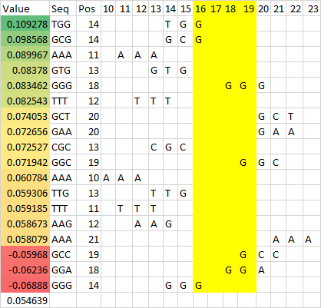
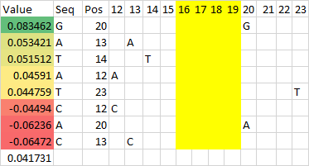
E2F4 GCGG
Notes:
BarGraph_E2F4_CoreGCGG_Feat13

Slide 10
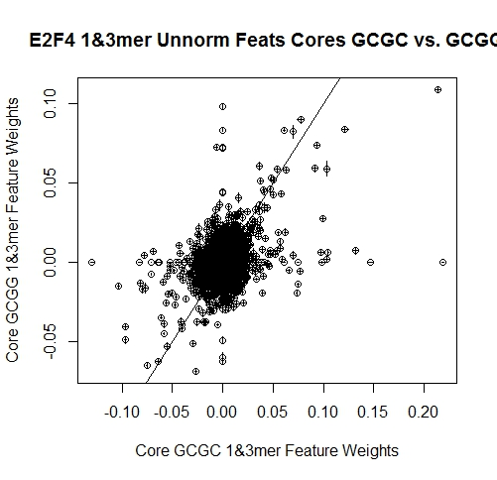
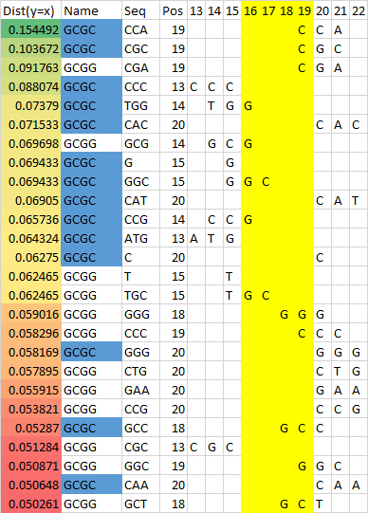
E2F4 Unnorm
Notes:
E2F4 comparison unnormalized
weights_E2F4_GCGCvsGCGG_unnormalized
graph_weights_E2F4_unnormalized

Slide 11
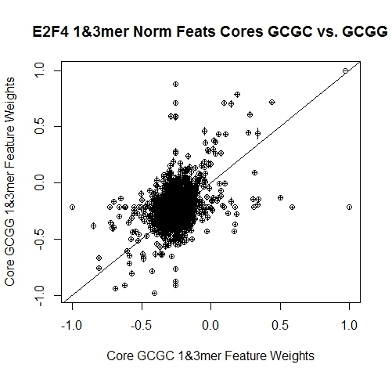
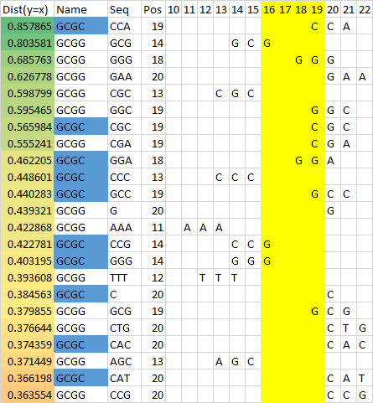
E2F4 Norm
Notes:
E2F4 comparison normalized
weights_E2F4_GCGCvsGCGG_normalized
graph_weights_E2F4_normalized

Slide 12
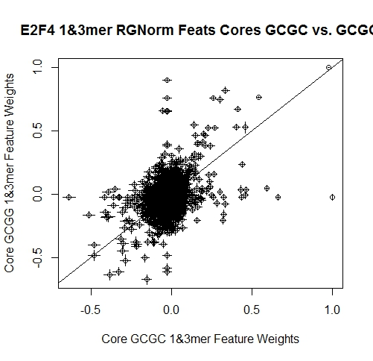
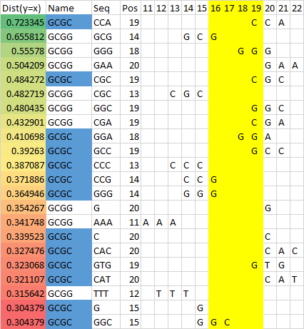
E2F4 RG Norm
Notes:
E2F4 comparison RG normalized
weights_E2F4_GCGCvsGCGG_RGnormalized
graph_weights_E2F4_RGnormalized

Slide 13
E2F4 Ranking
RG Norm
Ranking
Notes:
E2F1 comparison ranking
Ranking_E2F1_GCGCvsGCGG

Slide 14
E2F1
GCGC Comparison
E2F4
Notes:
GCGC

Slide 15
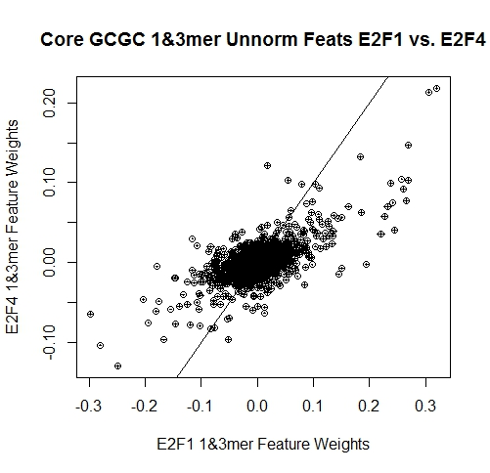
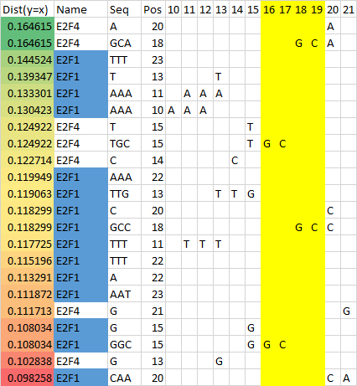
GCGC Unnorm
Notes:
GCGC unnormalized
weights_GCGC_E2F1vsE2F4_unnormalized
graph_weights_GCGC_unnormalized

Slide 16
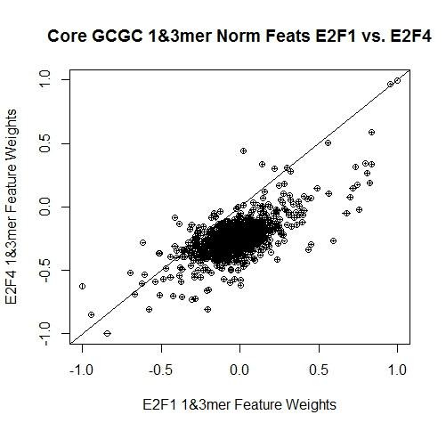
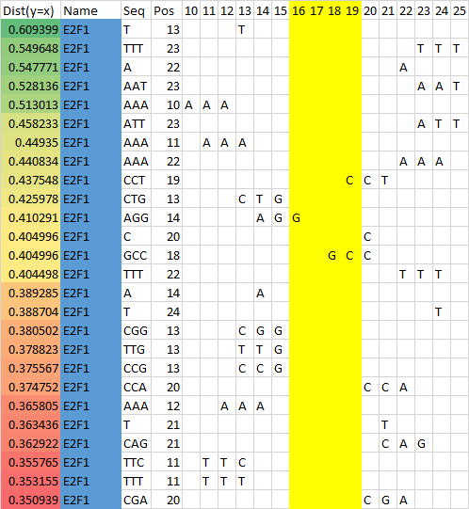
GCGC Norm
Notes:
GCGC normalized
weights_GCGC_E2F1vsE2F4_normalized
graph_weights_GCGC_normalized

Slide 17

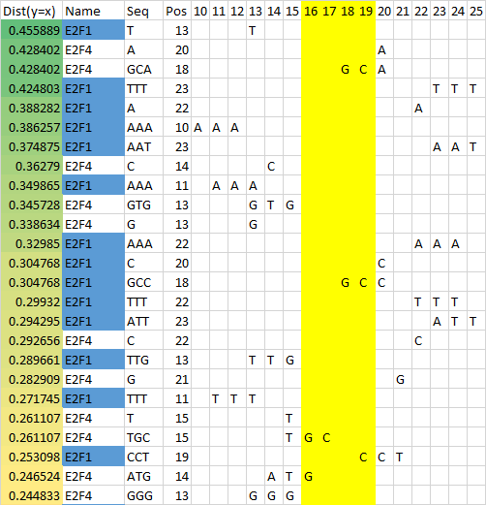
GCGC RG Norm
Notes:
GCGC RG normalized
weights_GCGC_E2F1vsE2F4_RGnormalized
graph_weights_GCGC_RGnormalized

Slide 18
GCGC Ranking
RG Norm
Ranking
Notes:
E2F1 comparison ranking
Ranking_E2F1_GCGCvsGCGG

Slide 19
E2F1
GCGG Comparison
E2F4
Notes:
GCGG

Slide 20
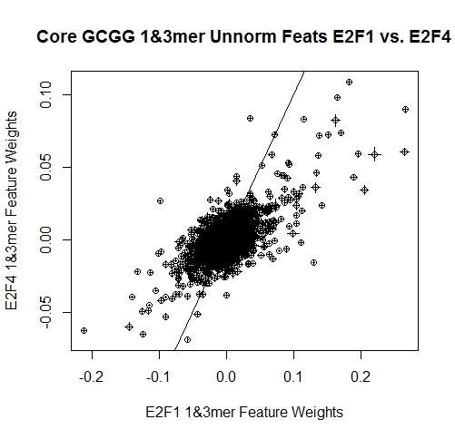
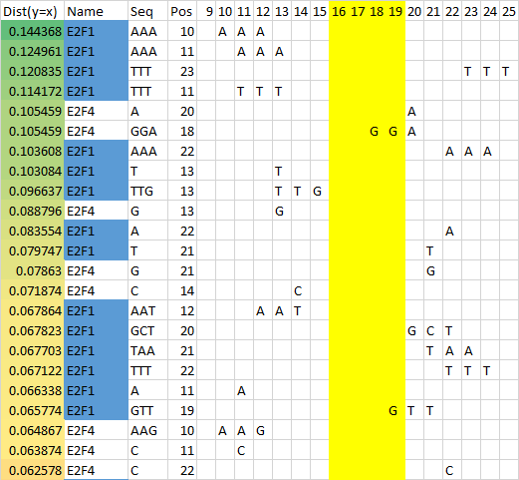
GCGG Unnorm
Notes:
GCGG unnormalized
weights_GCGG_E2F1vsE2F4_unnormalized
graph_weights_GCGG_unnormalized

Slide 21
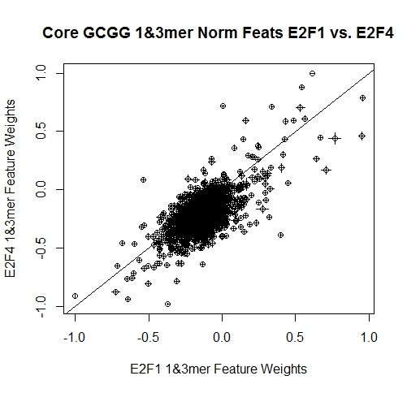
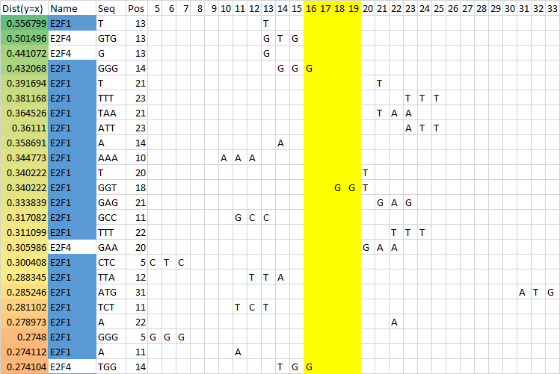
GCGG Norm
Notes:
GCGG normalized
weights_GCGG_E2F1vsE2F4_normalized
graph_weights_GCGG_normalized

Slide 22

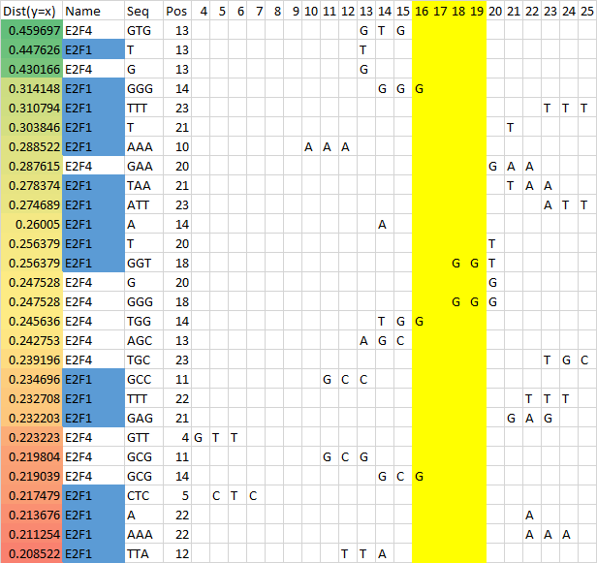
GCGG RG Norm
Notes:
GCGG RG normalized
weights_GCGG_E2F1vsE2F4_RGnormalized
graph_weights_GCGG_RGnormalized

Slide 23
GCGG Ranking
RG Norm
Ranking
Notes:
E2F1 comparison ranking
Ranking_E2F1_GCGCvsGCGG

Slide 24
End.
Todo 7/30
Weight cutoff from mean density and sd
Bug in ranking graph
Put e2f1s together, and e2f4s together
Do weight cutoff for RG norm graphs
Graph rankings too
Describe methods in writing
Todo 7/28:
Normalize differently
Ranking system
Ratio of the log intensities

